Slide 1
HILBERT CURVE
Prepared By,
Rutuja A Kulkarni
PICT, Pune

Slide 2
Fractals
Before starting Hilbert Curve lets understand
What is Fractal?
Fractals are very complex pictures generated by a computer from a single formula. They are created using iterations.
This means one formula is repeated with slightly different values over and over again, taking into account the results from the previous iteration.

Slide 3
Cont’d
Definition by B. MandelBrot:
A rough or fragmented geometric shape that can be subdivided in parts, each of which is (at least approximately) a reduced/size copy of the whole (self-similarity).
If you zoom any part of shape you can be able to same shape again.
Example: Mountains in nature, leaves, lighting bolt etc.

Slide 4
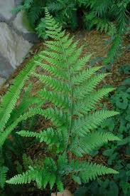
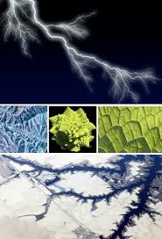

Slide 5
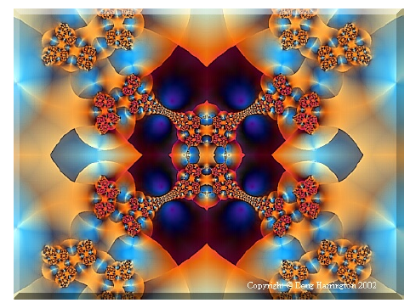

Slide 6


Slide 7
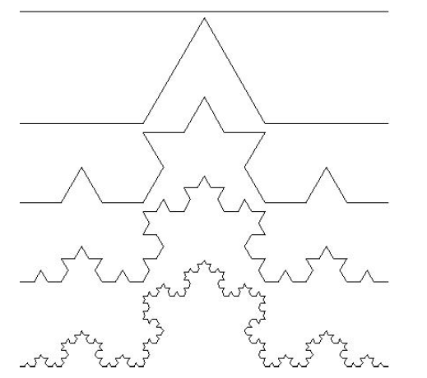
Generation of Fractals von Koch snowake
Step 1 to step 5
Each Line is
divided into
three points
continuously

Slide 8
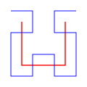

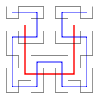
Hilbert Curve
A Hilbert curve (also known as a Hilbert space-filling curve) is a continuous fractal space-filling curve first described by the German mathematician David Hilbert in 1891.
Hilbert curve
first order first and first to
second orders third orders

Slide 9
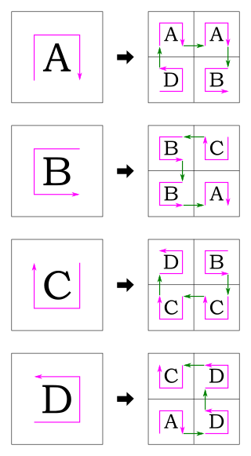
Production rule for Hilbert Curve

Slide 10
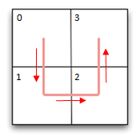
Recursion
The basic element of a Hilbert curve is a U-shape. Look at the image
Here we have a 2 x 2 square grid. We start with our ‘string’ in the top left corner, and drape it through the other three squares in the grid to finish in the top right corner.

Slide 11
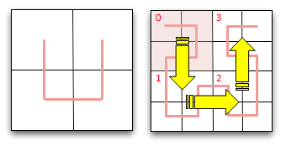
Cont’d
Now imagine that we double the size of the grid to make a 4 x 4 grid.
We can represent this 4 x 4 grid as a nested set of 2 x 2 grids, each of size 2 x 2
We want to traverse the grid at a high level following the 0->1->2->3 coarse pattern (shown by the big yellow arrows), and then within each of these grids, with a finer self-similar traversal pattern through each of the smaller grids.

Slide 12
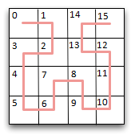
The result of this is shown on the left. This convoluted and snaking pattern passes through every square on the grid.

Slide 13
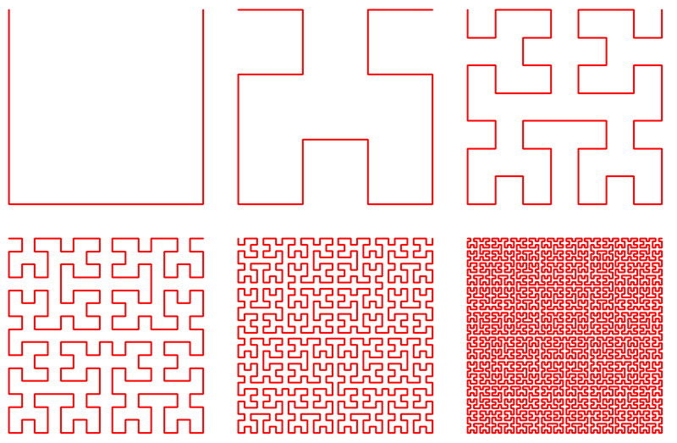
Here are some renderings of Hilbert Curves with ever increasing density:

Slide 14
Note: You can implement code in c++/Java in recursive manner.

